Slide 1



Raw Watch Dashboard
View in Power BI
Last data refresh:
5/14/2024 4:58:02 PM UTC
Downloaded at:
5/14/2024 5:03:45 PM UTC

Slide 2
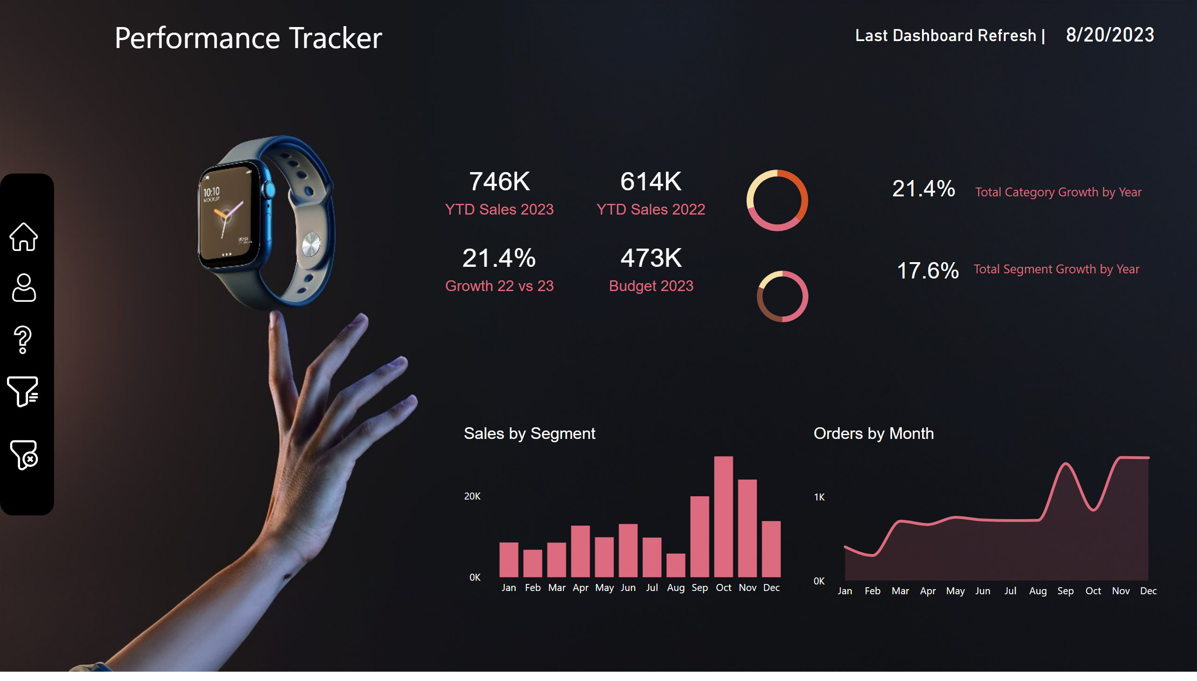
Performance Tracker
Notes:
Sales 2023 by Segment
No alt text provided
Sales 2023 by Category
No alt text provided
Orders by Month
No alt text provided
card
No alt text provided
card
No alt text provided
card
No alt text provided
card
No alt text provided
card
No alt text provided
card
No alt text provided
shape
No alt text provided
shape
No alt text provided
image
No alt text provided
image
No alt text provided
image
No alt text provided
image
No alt text provided
image
No alt text provided
shape
No alt text provided
shape
No alt text provided
card
No alt text provided
image
No alt text provided
slicer
No alt text provided
slicer
No alt text provided
slicer
No alt text provided
slicer
No alt text provided
shape
No alt text provided
slicer
No alt text provided
shape
No alt text provided
shape
No alt text provided
shape
No alt text provided
textbox
No alt text provided
shape
No alt text provided
Sales by Segment
No alt text provided

